Slide 1
Progress Update 2/3/23
Fei Du, Hannah Li, Lily Li, Eric Yoon

Slide 2
Updates
Created a subset of the CHIRPS 2.0 dataset for USA data only
We did not need to do any filtering for PRISM (non-USA data is set to NULL)
Using PRISM dataset as a standard, set all points that are NULL in PRISM dataset to NULL in CHIRPS
This leaves us with CHIRPS dataset where non-USA data is set to NULL
Got annual mean estimates across USA

Slide 3
Current Visualizations
Time series plots of average daily precipitation across the USA in 2018
Color map plot of yearly averages for the two datasets
Color map plot of monthly averages for the two datasets

Slide 4
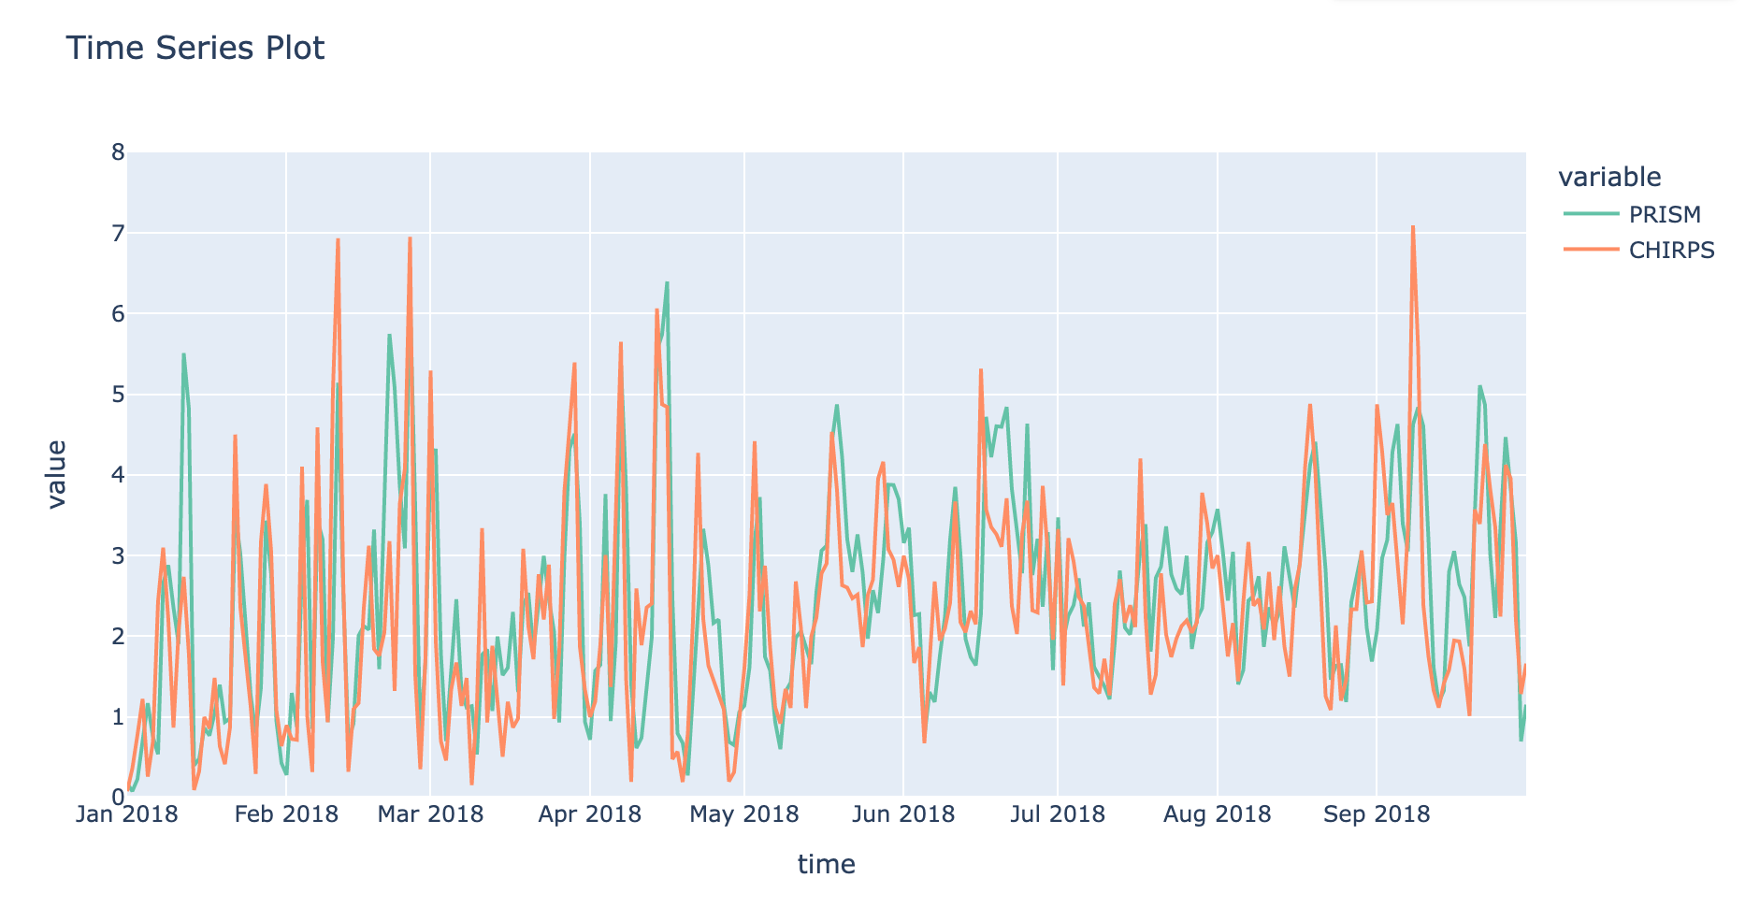
Interpretations:
General trends are same
Some differences on Jan 12th, Feb 21th, Sep 8th

Slide 5
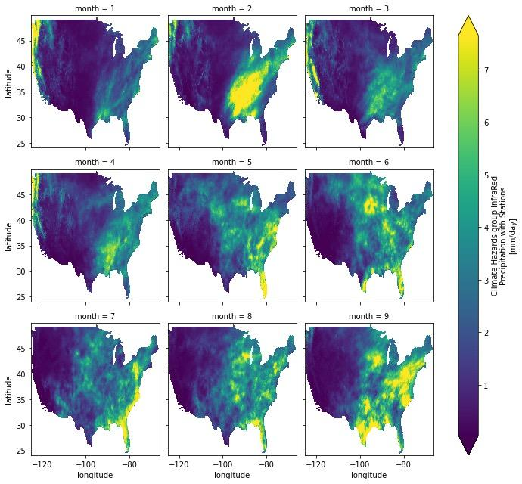
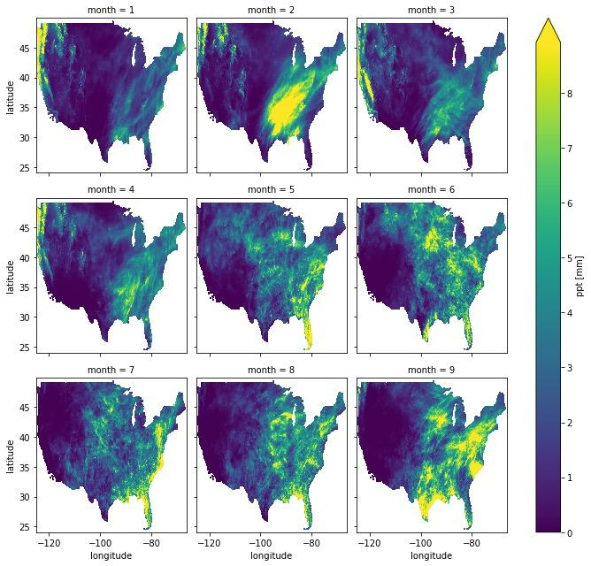
CHIRPS
PRISM

Slide 6
Issues
Different resolutions
PRISM’s grid is 4km x 4km while CHIRP’s grid is 5km x 5km
Consider spatial interpolation to fill in the gaps of where we don’t have site data
Different time scales
PRISM is January - September 2018 while CHIRPS is January - November 2018
Isolating USA data
Different methods utilizing longitude and latitude
Long run time for code
More efficient way?
After transforming & filtering data, need to save it instead of rerunning

Slide 7
Next Steps
Concrete metrics for comparison by coordinates
Another way of subtracting USA(or other regions) data
Additional visualizations
Incorporating precipitation thresholds (0-5mm, 5mm+, etc) into graphics

